Slide 1
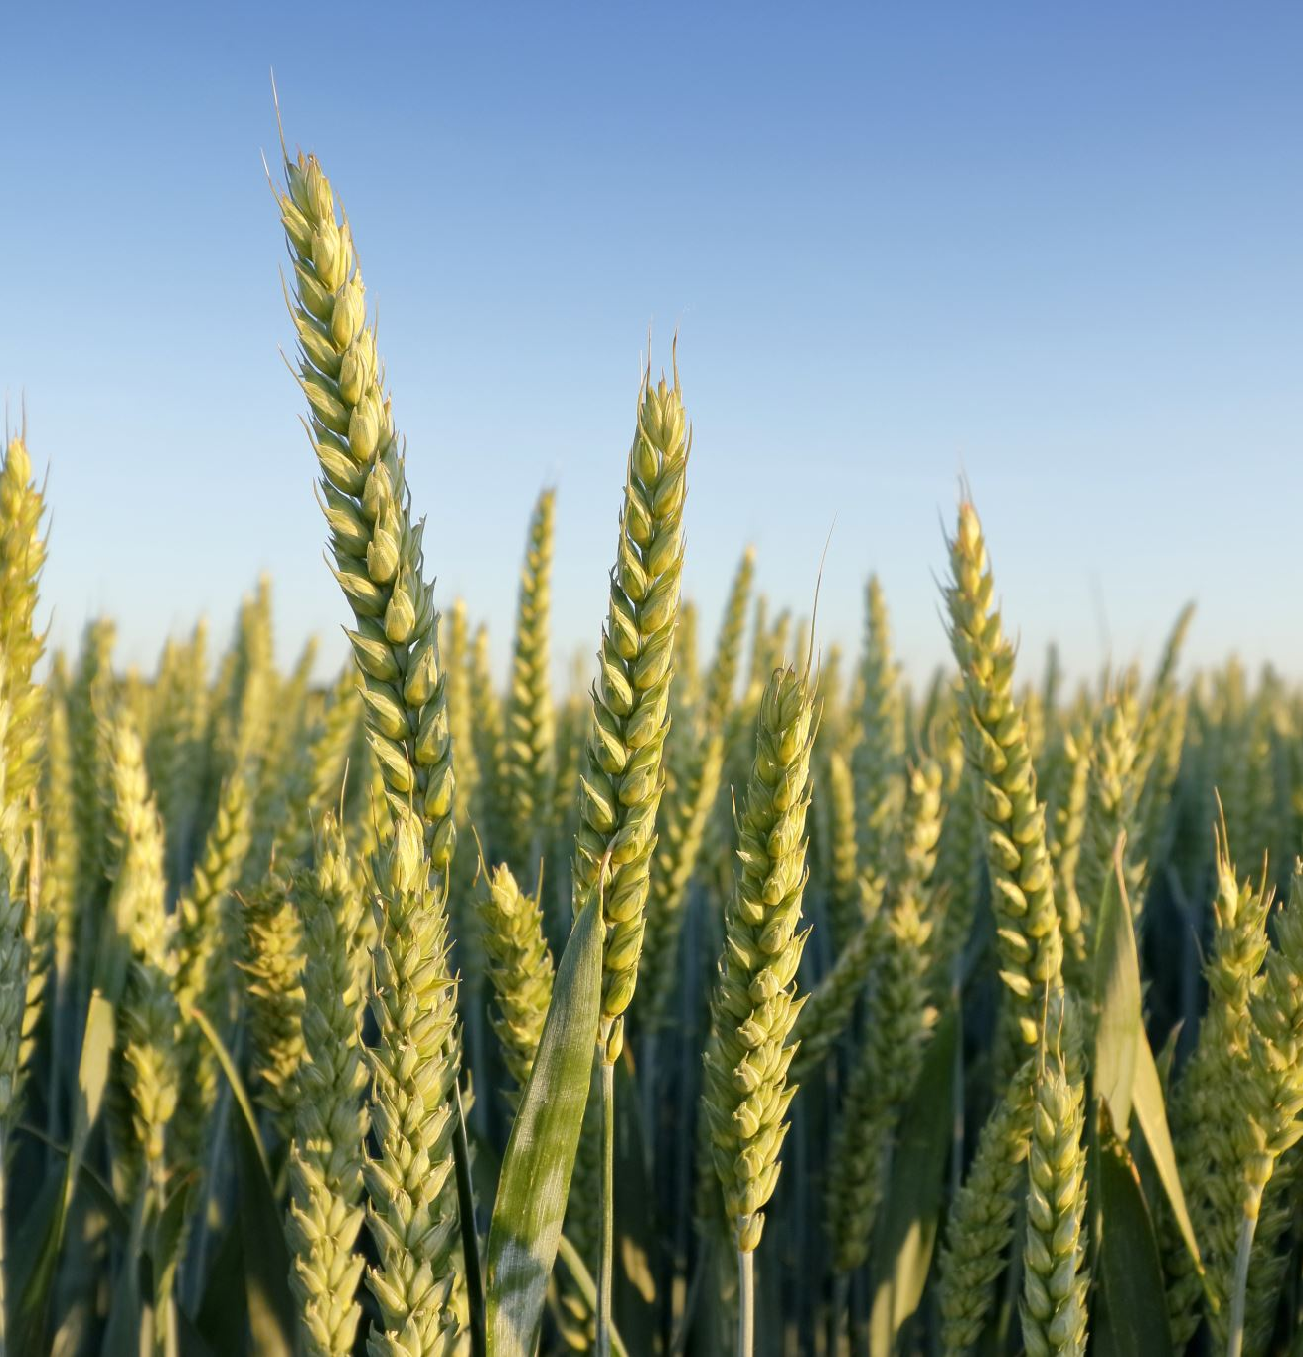
Topic: A model for predicting crop yield based on weather conditions and other environmental factors.
By: Katlego Motjolopane
GIS PROGRAMMING COURSE PROJECT

Slide 2

Crop Yield Prediction for National Planning and Food Security
Accurate crop output data is essential for effective national planning and ensuring food security. Satellite-based remote sensing offers a cost-effective, scalable solution for monitoring crops.
The proposed Crop Yield Prediction Model integrates geospatial analysis with environmental data to deliver reliable insights that support:
Agricultural planning
Resource management
Food security optimization
Justifications for a Crop Forecast Model:
Food Security: Helps anticipate shortages or surpluses for better planning.
Climate Adaptation: Enables farmers to develop coping strategies for climate change.
Efficient Resource Use: Supports sustainable use of water, fertilizers, and pesticides, reducing waste and environmental impact.

Slide 3
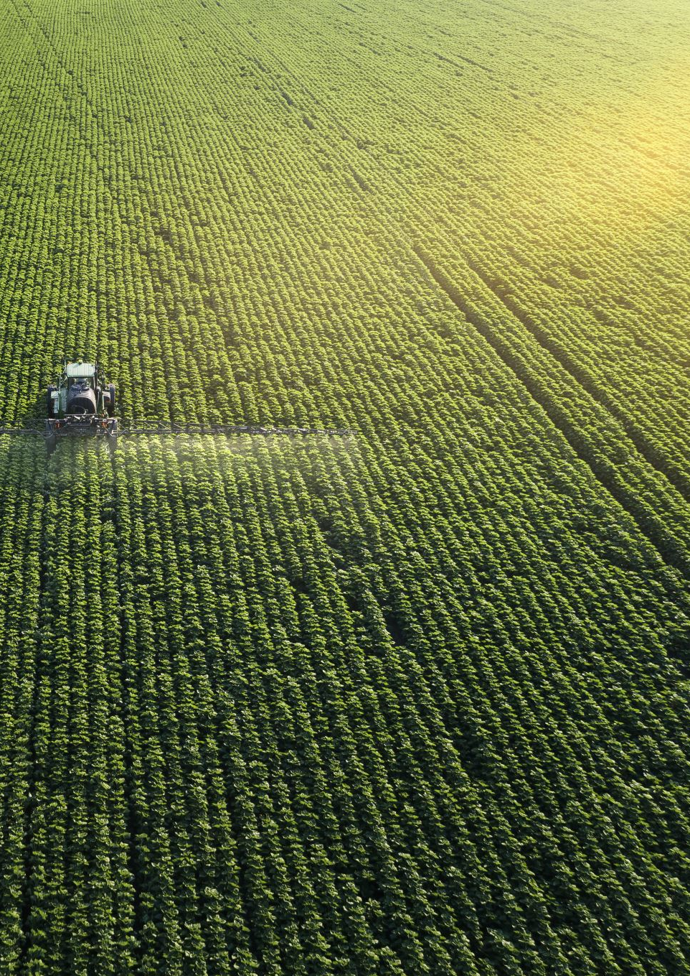
Objectives
Collect and analyse data related to soil type, weather patterns, and environmental factors affecting crop yield.
Develop a Python-centred model that predicts crop yield with near-accurate results.
Validate the model using previous agricultural data.
To provide a user-friendly interface for farmers and environmental stakeholders to access predictive insights.
Weather-related factors impacting crop yield.
Temperature, Rainfall, Humidity, Wind
Other factors to consider include:
Water Availability
Irrigation, water sources, and drought

Slide 4
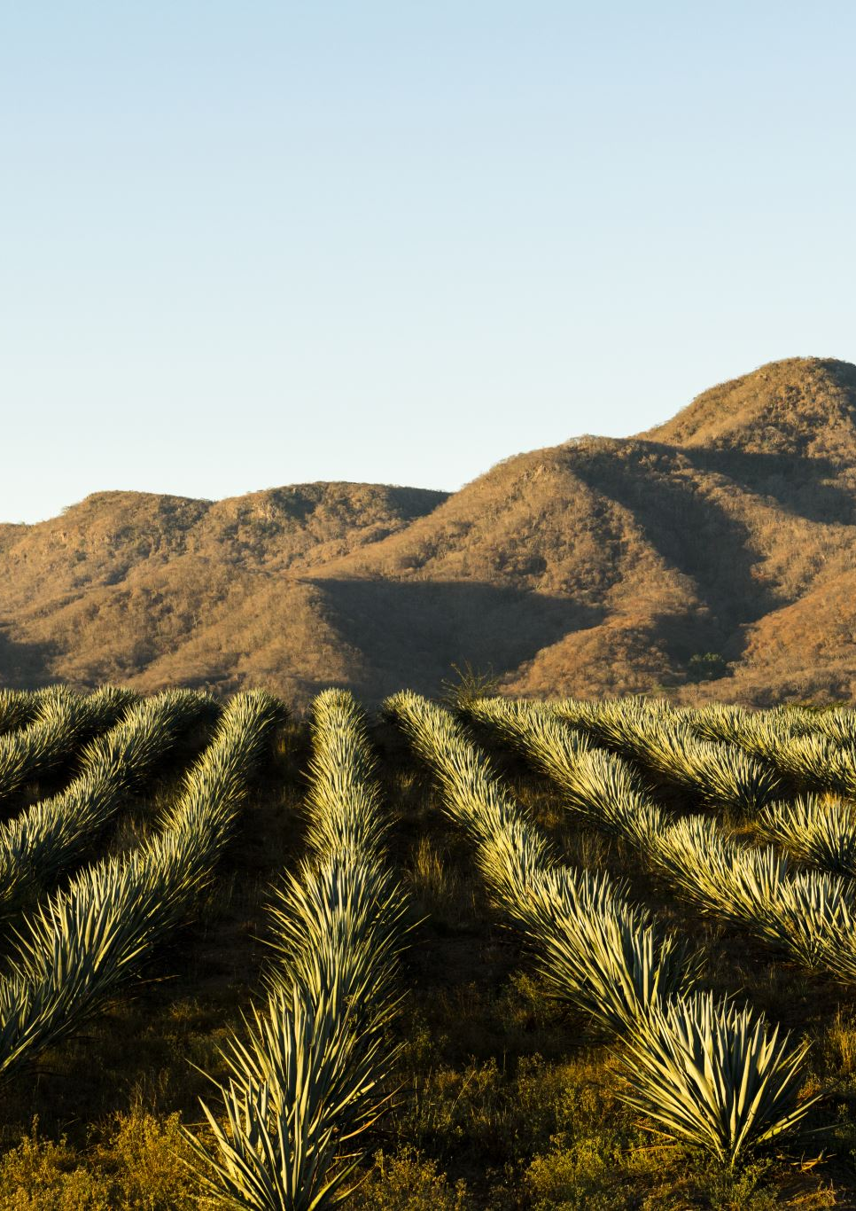
Analysis based on Namibia
The analysis was based on water sources and water distribution in and around Namibia.
characterized by arid and semi-arid climates, faces persistent water scarcity, and erratic rainfall patterns. These factors significantly influence agricultural productivity. Understanding the interplay between water availability and crop yields is essential for enhancing food security, improving planning, and adapting to climate variability.
Climatic and Geographic Overview
The Namib Desert (West): Extremely dry.
The Central Plateau: Variable rainfall.
The Kavango and Zambezi regions (Northeast): Higher rainfall and potential for higher agricultural productivity.
Rainfall: Varies from 25 mm/year in the coastal area to over 600 mm/year in the northeast. Growing season: Generally, from November to April, with most crops reliant on seasonal rainfall for high crop yield.

Slide 5
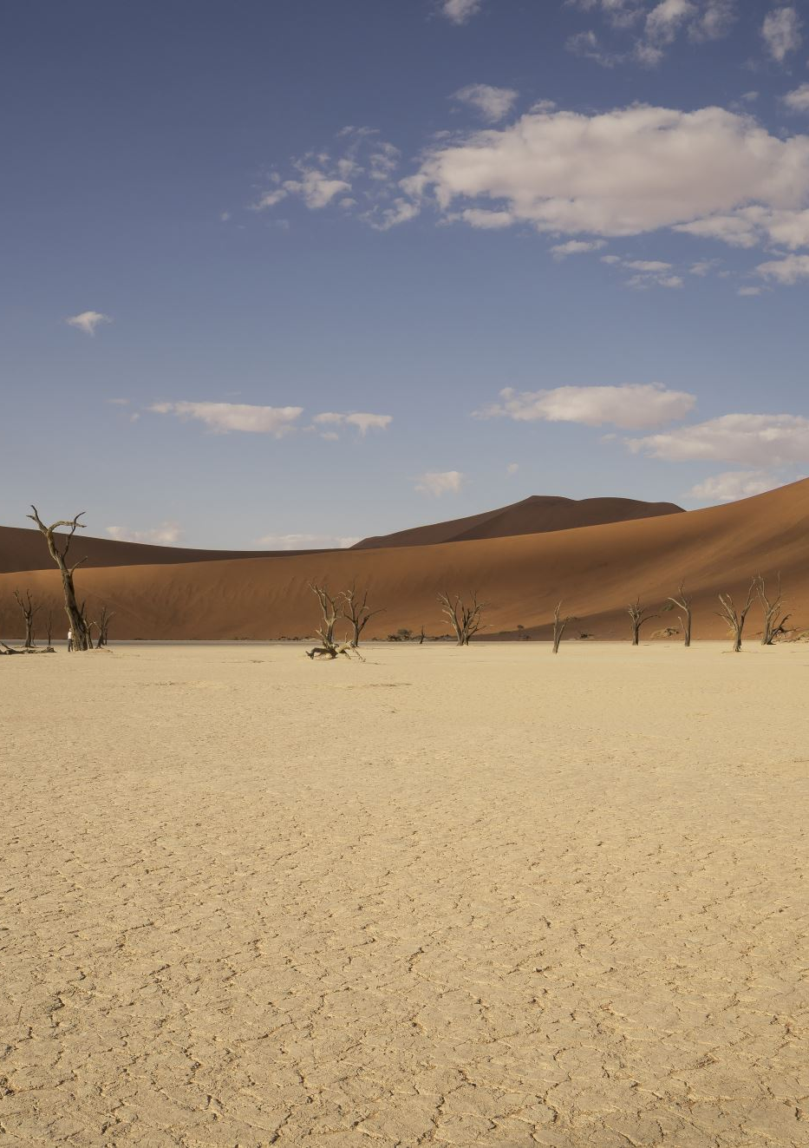
Water sources for crops
Source: Rain-fed
Dominant in subsistence farming regions (e.g., Omusati, Ohangwena, Kavango).
Vulnerable to drought and climatic changes
Source: Groundwater
Relied upon in central and southern Namibia
Deep boreholes are used for irrigation, especially on large farms
Source: Surface Water
Key rivers: Kunene, Kavango, Zambezi, and Orange Rivers
Hardap Dam and Naute Dam provide irrigation for commercial farms in the south

Slide 6
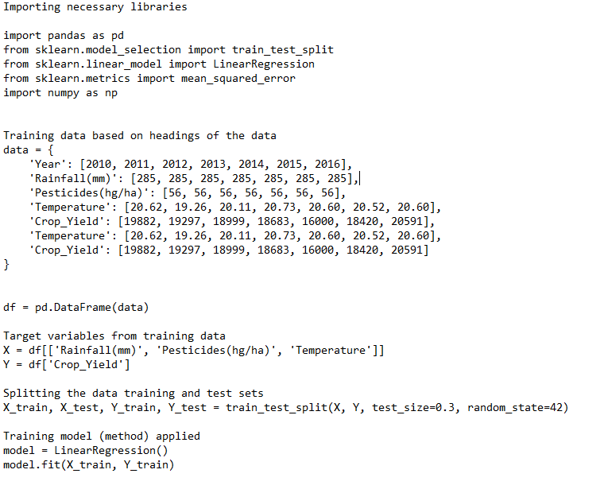
Method of data capture and predictions

Slide 7
Crop yield trends and their correlation to water availability
Region | Main Crops | Water Source | Average Yield (t/ha) | Water-related Constraints
Zambezi | Maize, millet | Rainfall, rivers | 1.5 – 2.2 | Flooding, pests
Kavango East/West | Maize, sorghum | Rainfall, Kavango R. | 1.2 – 2.0 | Seasonal variability
Hardap | Grapes, vegetables | Dams (Hardap) | 4.0 – 8.0 | Dam levels fluctuate
Otjozondjupa | Maize, beans | Boreholes | 1.0 – 1.5 | Groundwater stress, salinity
Ohangwena | Pearl millet | Rain-fed | 0.5 – 1.0 | Frequent droughts

Slide 8
Predictive Crop Yield Modeling
Linear regression:
A basic statistical technique that describes the linear relationship between one or more independent variables (such as temperature, rainfall, and pesticides) and one dependent variable crop yield).
Comparing Actual vs Expected Crop Yield:
Plotting the actual and expected crop yield data allows you to see how well the predicted and real values match up.
The model is effective if the predicted values closely match the actual values. The model's predictions are inaccurate if there is a large discrepancy between the actual and anticipated values.

Slide 9
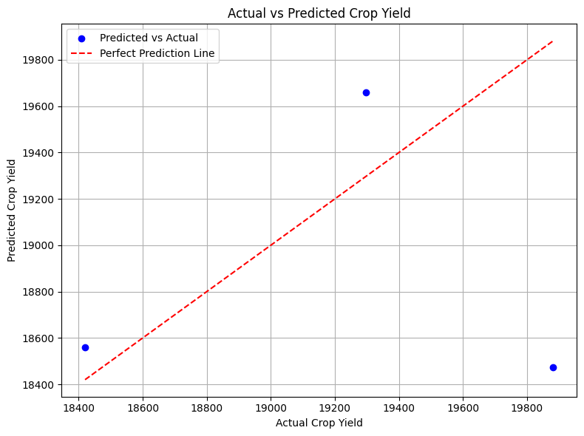
Model Testing
Comparing Actual vs Expected Crop Yield:
Plotting the actual and expected crop yield data allows you to see how well the predicted and real values match up.
The model is effective if the predicted values closely match the actual values. The model's predictions are inaccurate if there is a large discrepancy between the actual and anticipated values.
The scatter plot is visually inspectable: Good performance is indicated by a linearly aligned plot with points(blue) near a diagonal line (from bottom left to top right).

Slide 10
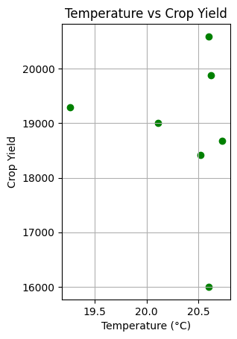
Temperature vs. Crop Yield (tons)
Testing the model by using the current or desired input temperature with the aid of the codes utilized to test the models, we can apply the following codes in Python to get an estimate of Crop Yield for 2025 based on temperature:

Slide 11
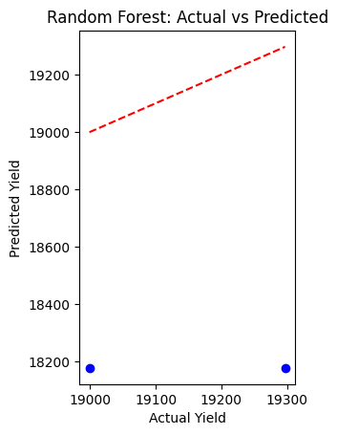
Building a Non-linear model for the crop yield prediction
Random Forest: To generate predictions, the machine learning method Random Forest employs a group of decision trees. It creates a more stable and accurate forecast by constructing several decision trees and integrating their output (voting for classification or averaging for regression).
Gradient Boosting Performance:
R-squared: -9.7955
Mean Squared Error: 239671.57
R-squared (R²): Indicates how effectively the model accounts for the variance in the desired outcome (crop yield).

Slide 12
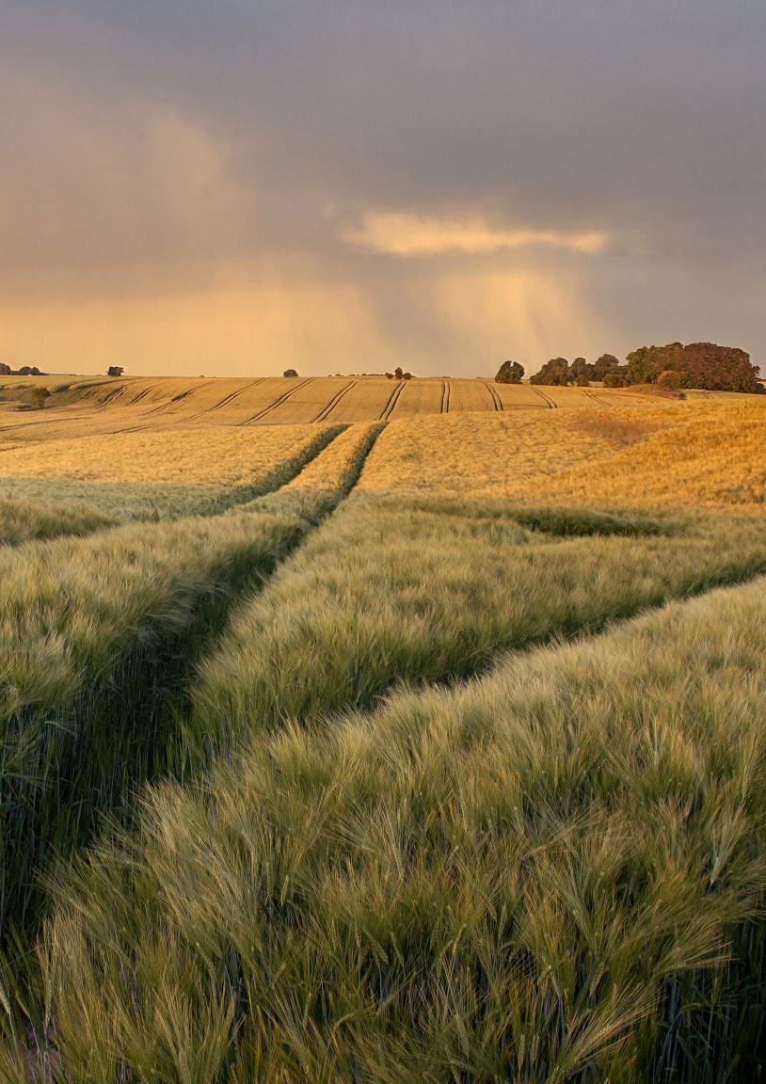
General observations:
The annual rainfall of 285 mm is consistent. Because rainfall is constant, the model may not detect enough variability to forecast crop yield based just on rainfall. Nonetheless, the model can take into consideration the trend in crop output over time by using the crop yield from the prior year as a feature.
In conclusion, evaluate the model's performance using both visual inspection (actual vs. projected plot) and numerical metrics (such as R2 and MSE) after testing. You can either use more sophisticated techniques to increase the accuracy of the current model or make improvements based on this evaluation.

